Slide 1
BIS 403 - Applied Systems Design College: Peirce College Professor: Robert Heubner Group Members: J. Sherif & M. Morrison Case Study: Personal Trainer Case Study #7
Date: 2/11/2024
Tasks 1&2, completed by Jilalo Sherif
Tasks 3&4, completed by Morrese Morrison

Slide 2
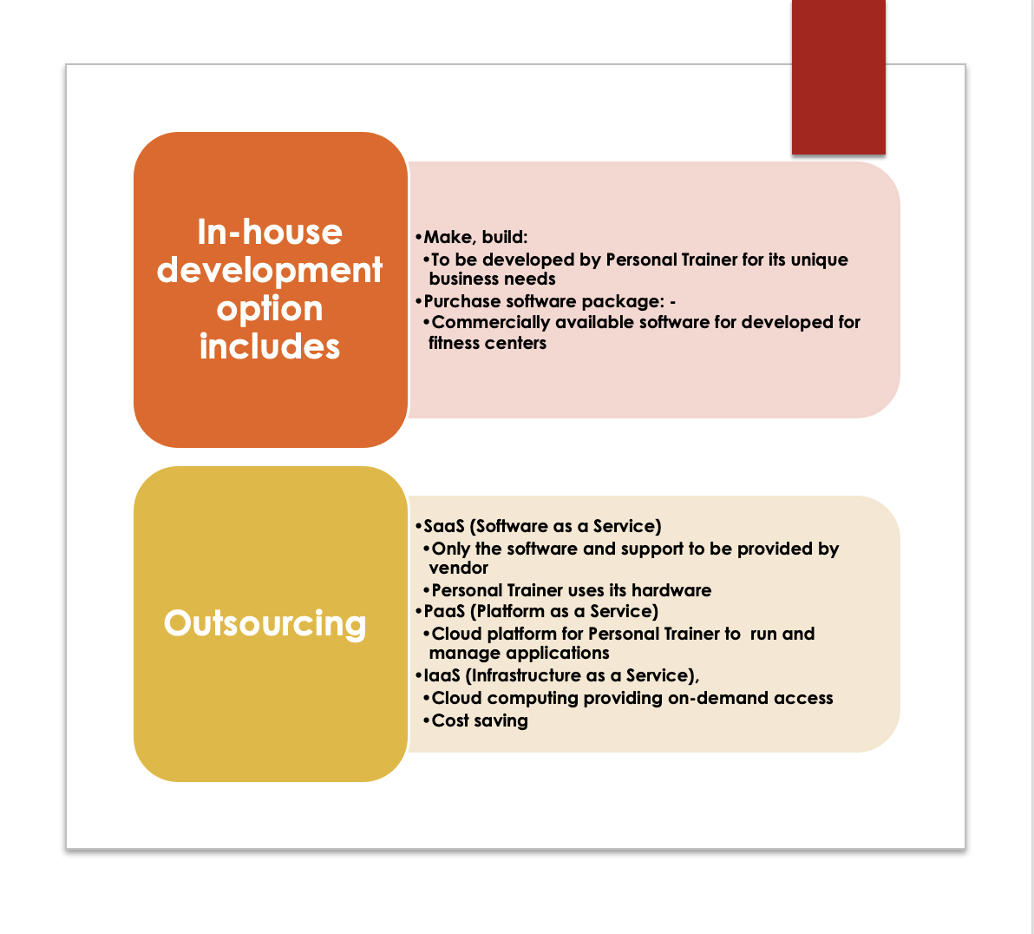
List of Options For Developing A New System

Slide 3
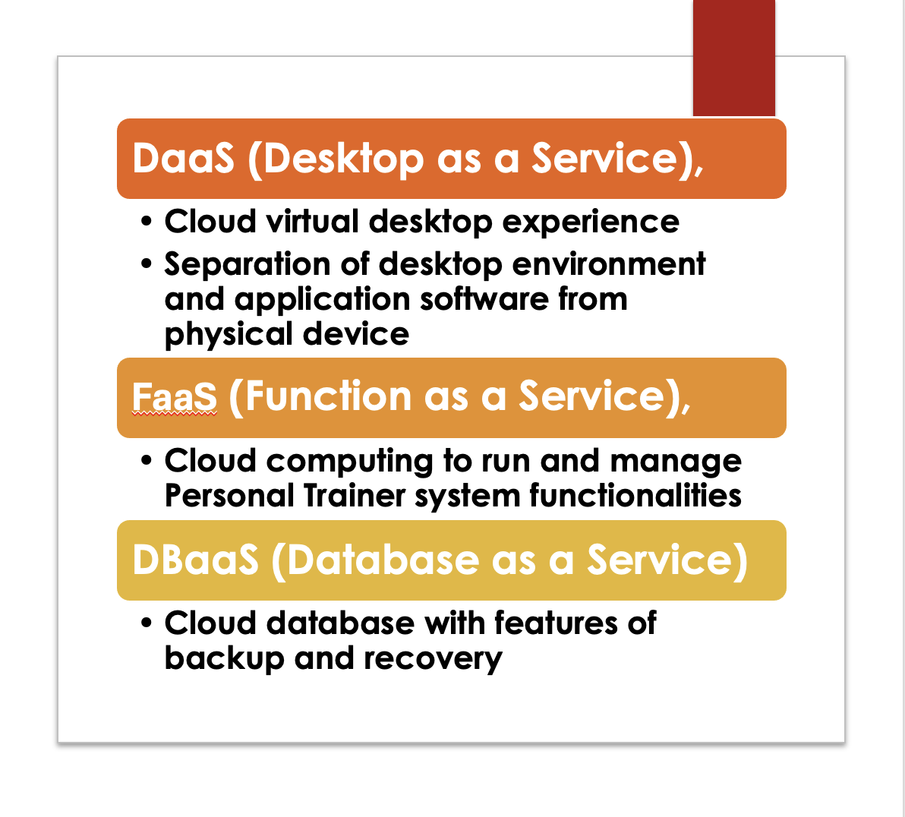
Options For Developing A New System (CTD)

Slide 4
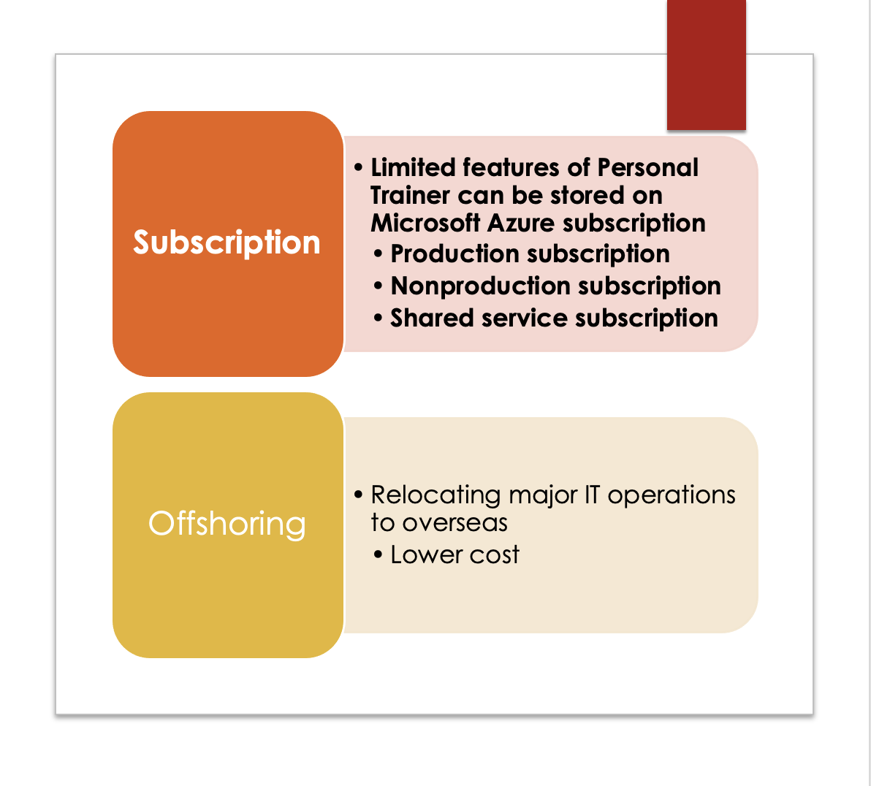
Options For Developing A New System (CTD)

Slide 5
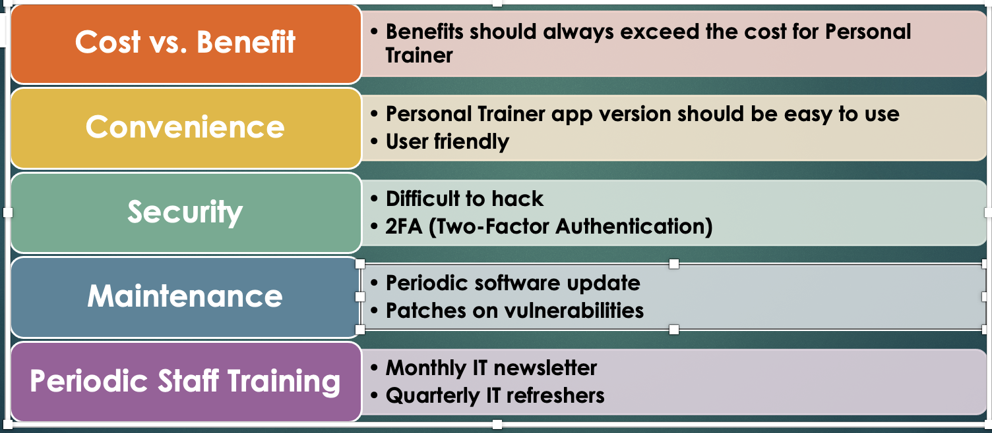
Specific Issues & Options To Consider

Slide 6
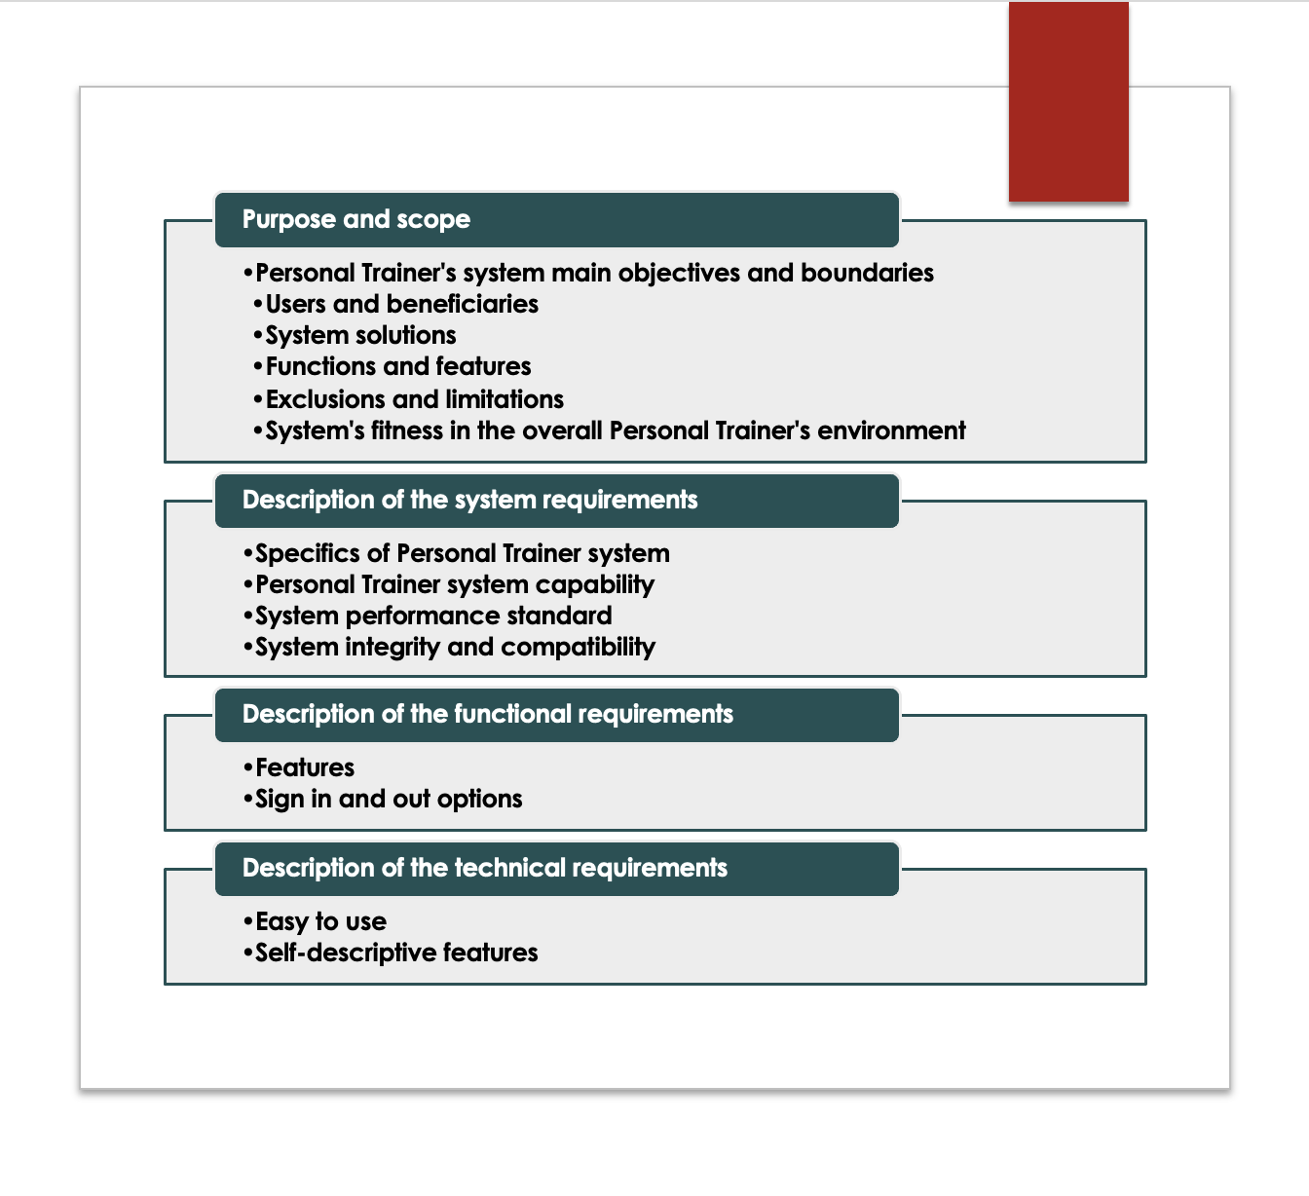
Main Elements Of The System Requirement Document

Slide 7
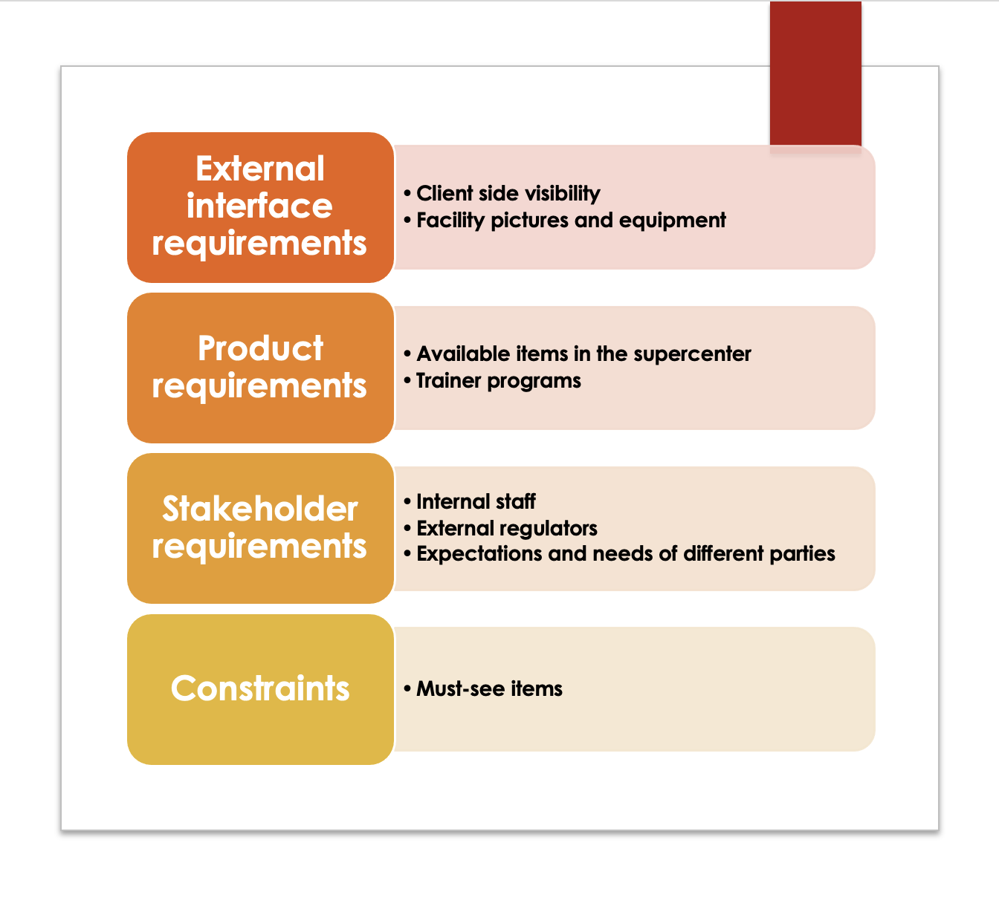
Main Elements Of The System Requirement Document

Slide 8
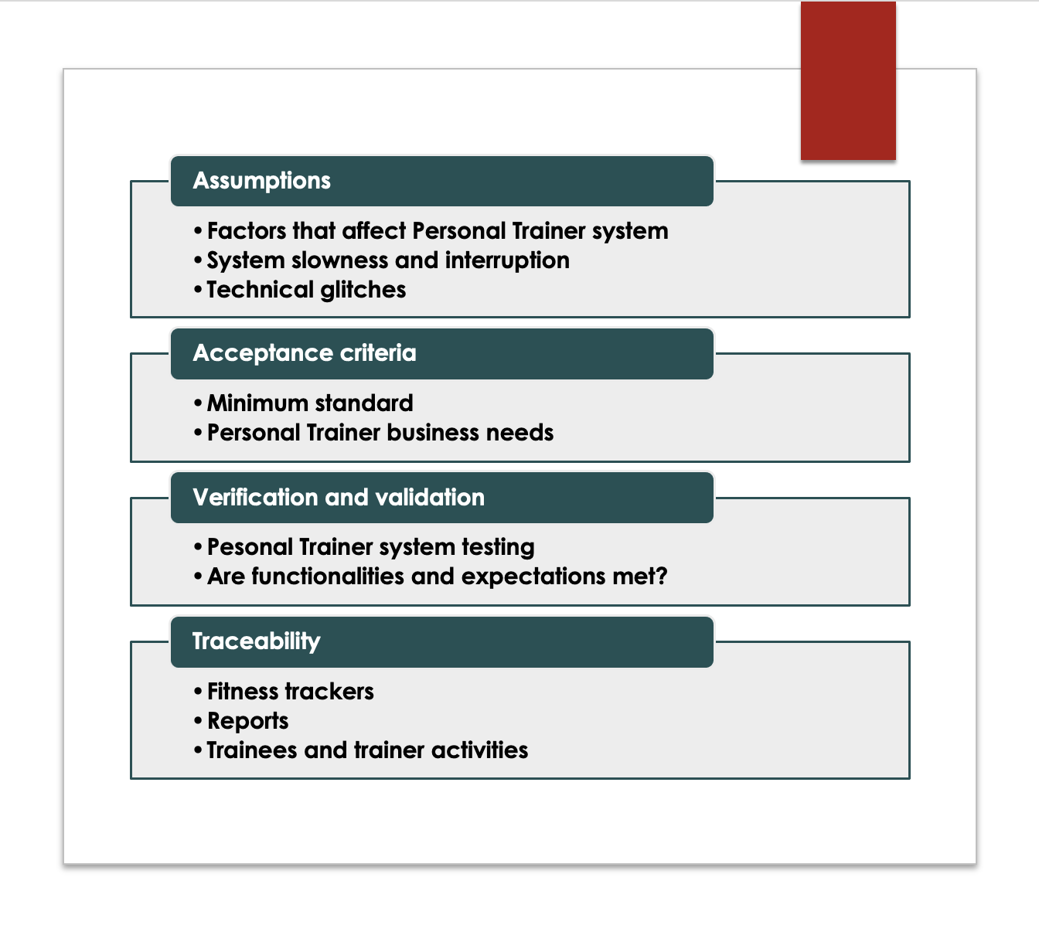
Main Elements Of The System Requirement Document

Slide 9
Utilization Of Visual Aids
Visual Aids serve as a medium to demonstrate a concept, idea or product.
Video visual aids can be extremely effective, giving those who watched the presentation a lasting memory of what was shown.
Video visual aid should be utilized to show the system.

Slide 10
Total Cost Of Ownership
Total cost of ownership is determined by the price of the asset in questioned in addition to operational costs of a certain value of time
This is crucial in determining the economic feasibility of a project before it is started.
Various financial tools are available to calculate TCO. However they all come with Pro’s and Con’s.
Only one method is correct to accurately calculate TCO in this scenario.

Slide 11
Financial Analysis Tools (Pros & Cons)
Payback Analysis
Ignores Time of Value
Ignores Cash Flows Beyond The Payback Period
Easy To Calculate
Shorter Payback Period
ROI (Rerun On Investment)
Focuses Only On Financial Impact, Disregards Non Financial Benefits
Need To Thoroughly Understand All Project Related Expenses
Easiest To Calculate
Can Apply To Short Term & Long Term Projects
Present Value Analysis
Accuracy Depends On Quality Of Inputs
Short Term Focused
Incorporates Time Value Of Money (Inflation, Interest Rates)
Excellent Way To Predict Value Outcomes

Slide 12
Optimal Tool To Calculate TCO
The optimal way to calculate TCO is to utilize the TCO formula.
The TCO formula consists of the following formula I + M – R = TCO.
Initial cost (I), Maintenance costs over 3 years (M), and the remaining value after 3 years of depreciation (R).

